Slide 1
16. Max-heap
ECE 309
Dr. James Tuck

Slide 2
Objectives
Define max-heap, it’s structure, and common operations.
Describe and implement a max-heap using an array in C++.
Describe pseudocode for max-heap percolate up, percolate-down, insert, and remove
Explain how to use a max-heap to sort an array.
Implement heapsort in C++.
Compare the big-O time complexity of max-heap operations.

Slide 3
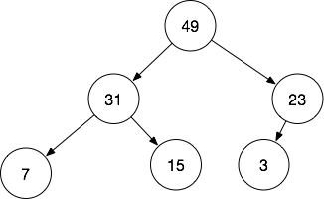
Idea for the heap
Maintaining objects in a fully sorted order, as in a BST, is unnecessary for some applications.
Suppose you only need to find the maximum value.
We can organize nodes differently to make finding the max easy.

Slide 4
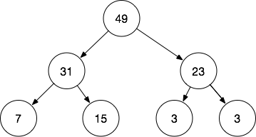
Max-heap
A max-heap requires that a node is greater or equal to its children.
There is no requirement about the ordering of left and right children.
The root node must be the maximum value in a max-heap.

Slide 5
Max-heap operations
insert: add a new value to the heap
remove: remove the max value
Just like in a BST, these operations must preserve the max-heap property

Slide 6
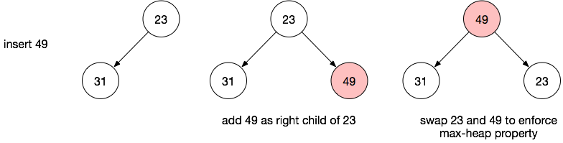
Max-heap Insert
New nodes are added at the bottom of the tree and percolated up the tree into position.

Slide 7
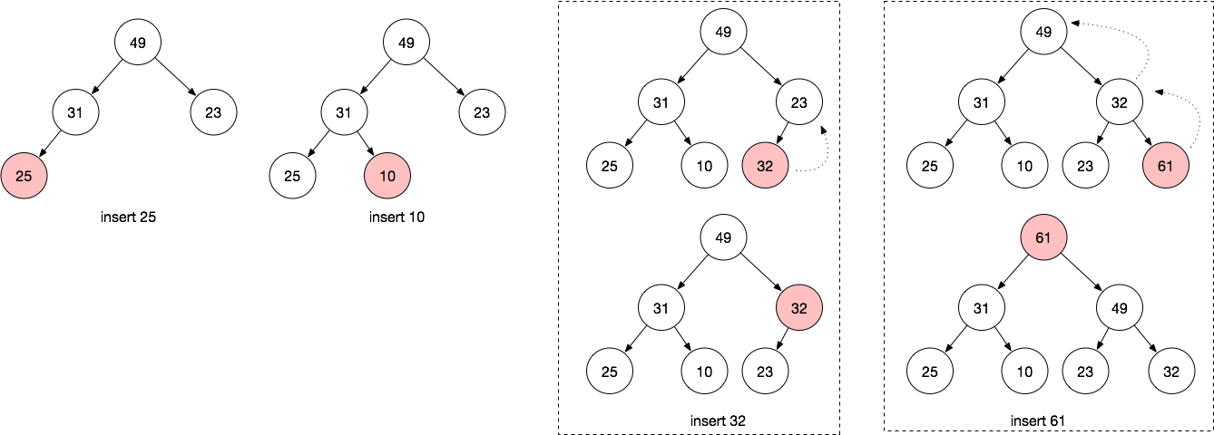
More insert examples
Nodes are added to fill up the lower level of the tree.

Slide 8
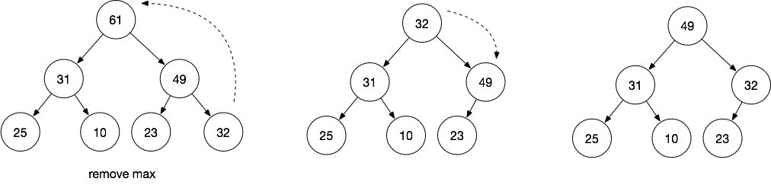
Max-heap Remove
Replace the root with the last element in the lowest level and recursively swap with a larger child until max-heap is restored.

Slide 9
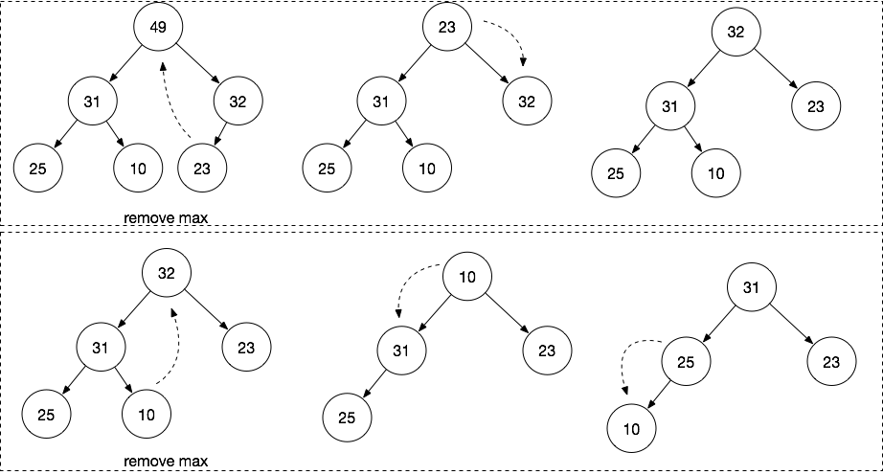
More remove examples

Slide 10
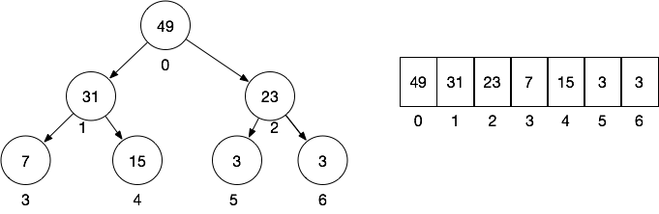
Heap storage
Heaps are often organized as an array rather than a linked data structure.
The root is always index 0. Index 1 and 2 are the root’s children.

Slide 11
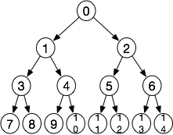
How to find the child nodes?
Since we don’t have right and left child pointers, we need a different way to find the children of a node.
Node Index | Parent Index | Child Indices
0 (root) | None | 1 and 2
1 | 0 | 3 and 4
2 | 0 | 5 and 6
3 | 1 | 7 and 8
4 | 1 | 9 and 10
i | floor( (i-1)/2 ) | 2*i+1, 2*i+2

Slide 12
Examples
Children of node 17: 17*2+1=35, 17*2+2 = 36
Parent of 17: floor( (17-1)/2 ) = 8
Children of node 100: 100*2+1 = 201, 100*2+2 = 202
Parent of 100: floor( (100-1)/2 ) = 49

Slide 13
A couple of things to note
We should never calculate the parent index of the root (it’s not meaningful)
Don’t access children past the length of the array
We can always compute a child’s index but it’s not always valid.
The heap array will be fixed in length.
The end of the array is the end of the heap.
We use the first n-1 entries before using n
There are no gaps in the array; guarantees a complete tree.

Slide 14
MaxHeap Object Member Variables
heapArray: heap array
heapArraySize: size of storage
nextIndex: next unused location in heapArray; can also be thought of as the length of the heap

Slide 15
MaxHeapInsert pseudocode
MaxHeapInsert(data) {
if (nextIndex < heapArraySize) {
heapArray[nextIndex] = data; // add to next free spot
MaxHeapPercolateUp(nextIndex);
nextIndex++;
return true;
}
return false;
}

Slide 16
MaxHeapPercolateUp pseudocode
MaxHeapPercolateUp(nodeIndex) {
while(nodeIndex > 0) {
parentIndex = (nodeIndex-1)/2;
if (heapArray[nodeIndex] > heapArray[parentIndex]) {
// bigger than parent, so swap them
swap(parentIndex, nodeIndex);
nodeIndex = parentIndex;
} else
return;
}
}

Slide 17
MaxHeapRemove pseudocode
MaxHeapRemove() {
// assume heap is not empty
val = heapArray[0];
heapArray[0] = heapArray[nextIndex-1];
nextIndex -= 1;
MaxHeapPercolateDown(0,nextIndex);
return val;
}

Slide 18
MaxHeapPercolateDown pseudocode
MaxHeapPercolateDown(nodeIndex, size) {
val = heapArray[nodeIndex];
child_index = nodeIndex*2+1;
while(child_index < size){
max_val = val;
max_index = -1;
for (i=child_index; i<child_index+2 && i<size; i++)
if(heapArray[i] > max_val) {
max_val = heapArray[i];
max_index = i;
}
if (max_val == val) return; // nothing else to do
swap(max_index,nodeIndex);
nodeIndex = max_index;
child_index = 2*nodeIndex + 1;
}
}

Slide 19
MaxHeap implementation in C++
Implement the MaxHeap object in C++.

Slide 20
Heapsort
We can use a max-heap to sort an array efficiently.
First, heapify the array - change the unsorted array into a legal max-heap
Then, remove the max item one at a time to sort the array in reverse

Slide 21
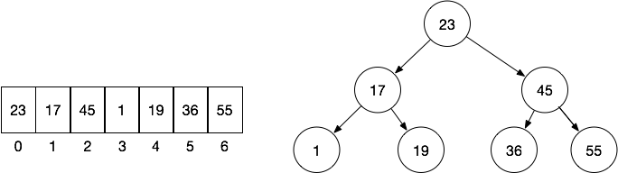
Example of heapify
Interpret the array as a heap, but it’s not yet legal.

Slide 22
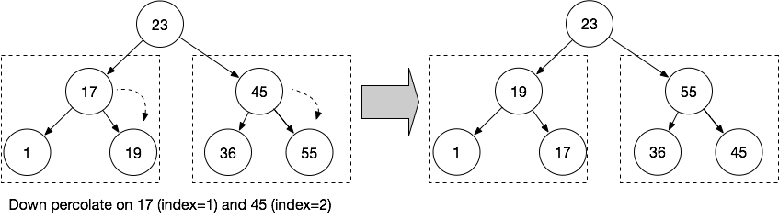
Example of heapify (part 2)
Down percolate on the last internal level of the tree.
Still not legal yet, root is incorrect. But last two levels are legal.

Slide 23
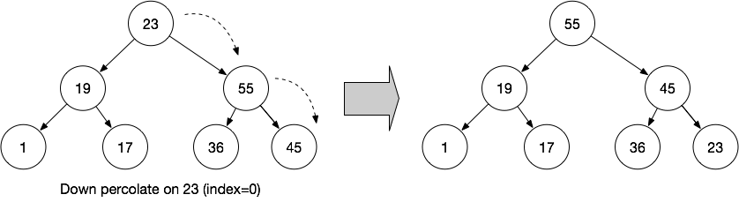
Example of heapify (part 3)
Down percolate on the next higher internal level.

Slide 24
The heapify operation
The heapify operation converts an unsorted array into a legal max-heap.
heapify() {
m = get the last used internal node index // everything after is a leaf
while( m >= 0 ) {
MaxHeapPercolateDown(m);
m--;
}
}

Slide 25
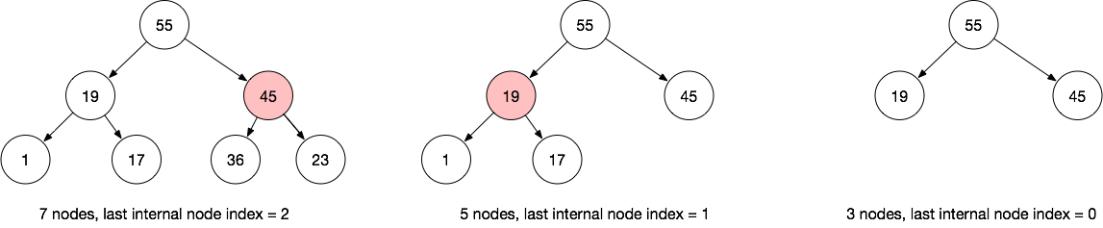
Last internal node
The last internal node is the parent of the last node.
Last internal node index = (n-1)/2, where n is index of the last node.

Slide 26
Back to heapsort
First, heapify the array - change the unsorted array into a legal max-heap
Then, remove the max item one at a time to sort the array in reverse, from greatest to least

Slide 27
Heapsort pseudocode
heapsort(numbers, numbersSize) {
// Copy numbers array into MaxHeap object heapify(); for (i = nextIndex - 1; i > 0; i--) {
// move max item out of the heap; clever trick -- put it at the end
// of the array to avoid allocating new memory swap numbers[0] and numbers[i] MaxHeapPercolateDown(0, i) } }

Slide 28
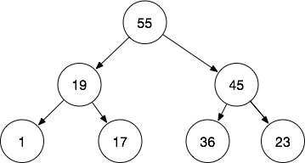
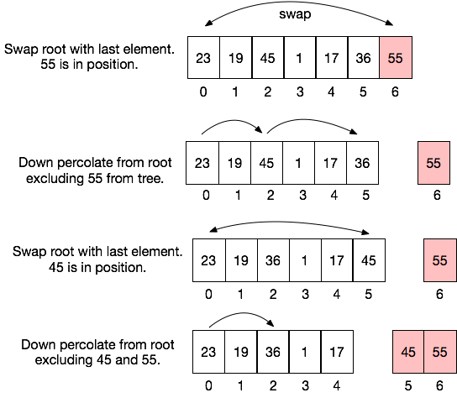

Example of heapsort
Heapified array.
Repeat until fully sorted.

Slide 29
Heapsort implementation
Add support for heapsort to the MaxHeap class.
Add a constructor that allows us to pass in our own integer array for sorting.

Slide 30
Time complexity of heap operations
Operation (length N) | Big-O Time Complexity | Explanation
Percolation up/down | O(log N) | May require traversing all levels of the tree, so the cost is determined by tree height (H). Hence, O(log N)
insert | O(log N) | We copy the item to the last free index, thats O(1). But, then it’s percolated up, which is O(log N).
remove | O(log N) | Finding the root is fast (O(1)). But, we swap it for the last index and down percolate, that is O(log N).
heapify | O(N log N) | We must visit N/2 nodes and perform down percolation. N/2 * log N => O(N log N)
heapsort | O(N log N) | Heapify is O(N log N). Then, removing the max item N times and down percolating is also O(N log N). N log N + N log N => O(N log N).

Slide 31
Summary
Max-heaps are handy when you only need to find the maximum (or minimum) value in a collection.
A node in a max-heap is guaranteed larger than any of its children or nodes in its sub-trees.
Max-heaps are implemented on arrays because they are complete trees, making indexing relatively simple.
Remove and insert operations are efficient O(log N)
Heapsort is a sorting algorithm based on max-heaps, and it operates in O(N log N).

Slide 32
References
1. ZyBook on Data Structures, chapters 16.11, 16.12, and 16.13

